Slide 1

DevOps With AWS New Batch Update
Next Batch Update and Training Timings In Description
Language: Telugu
Trainer Rushi
Mode: Online & Offline
Contact:8374331435 ,7013882648

Slide 2
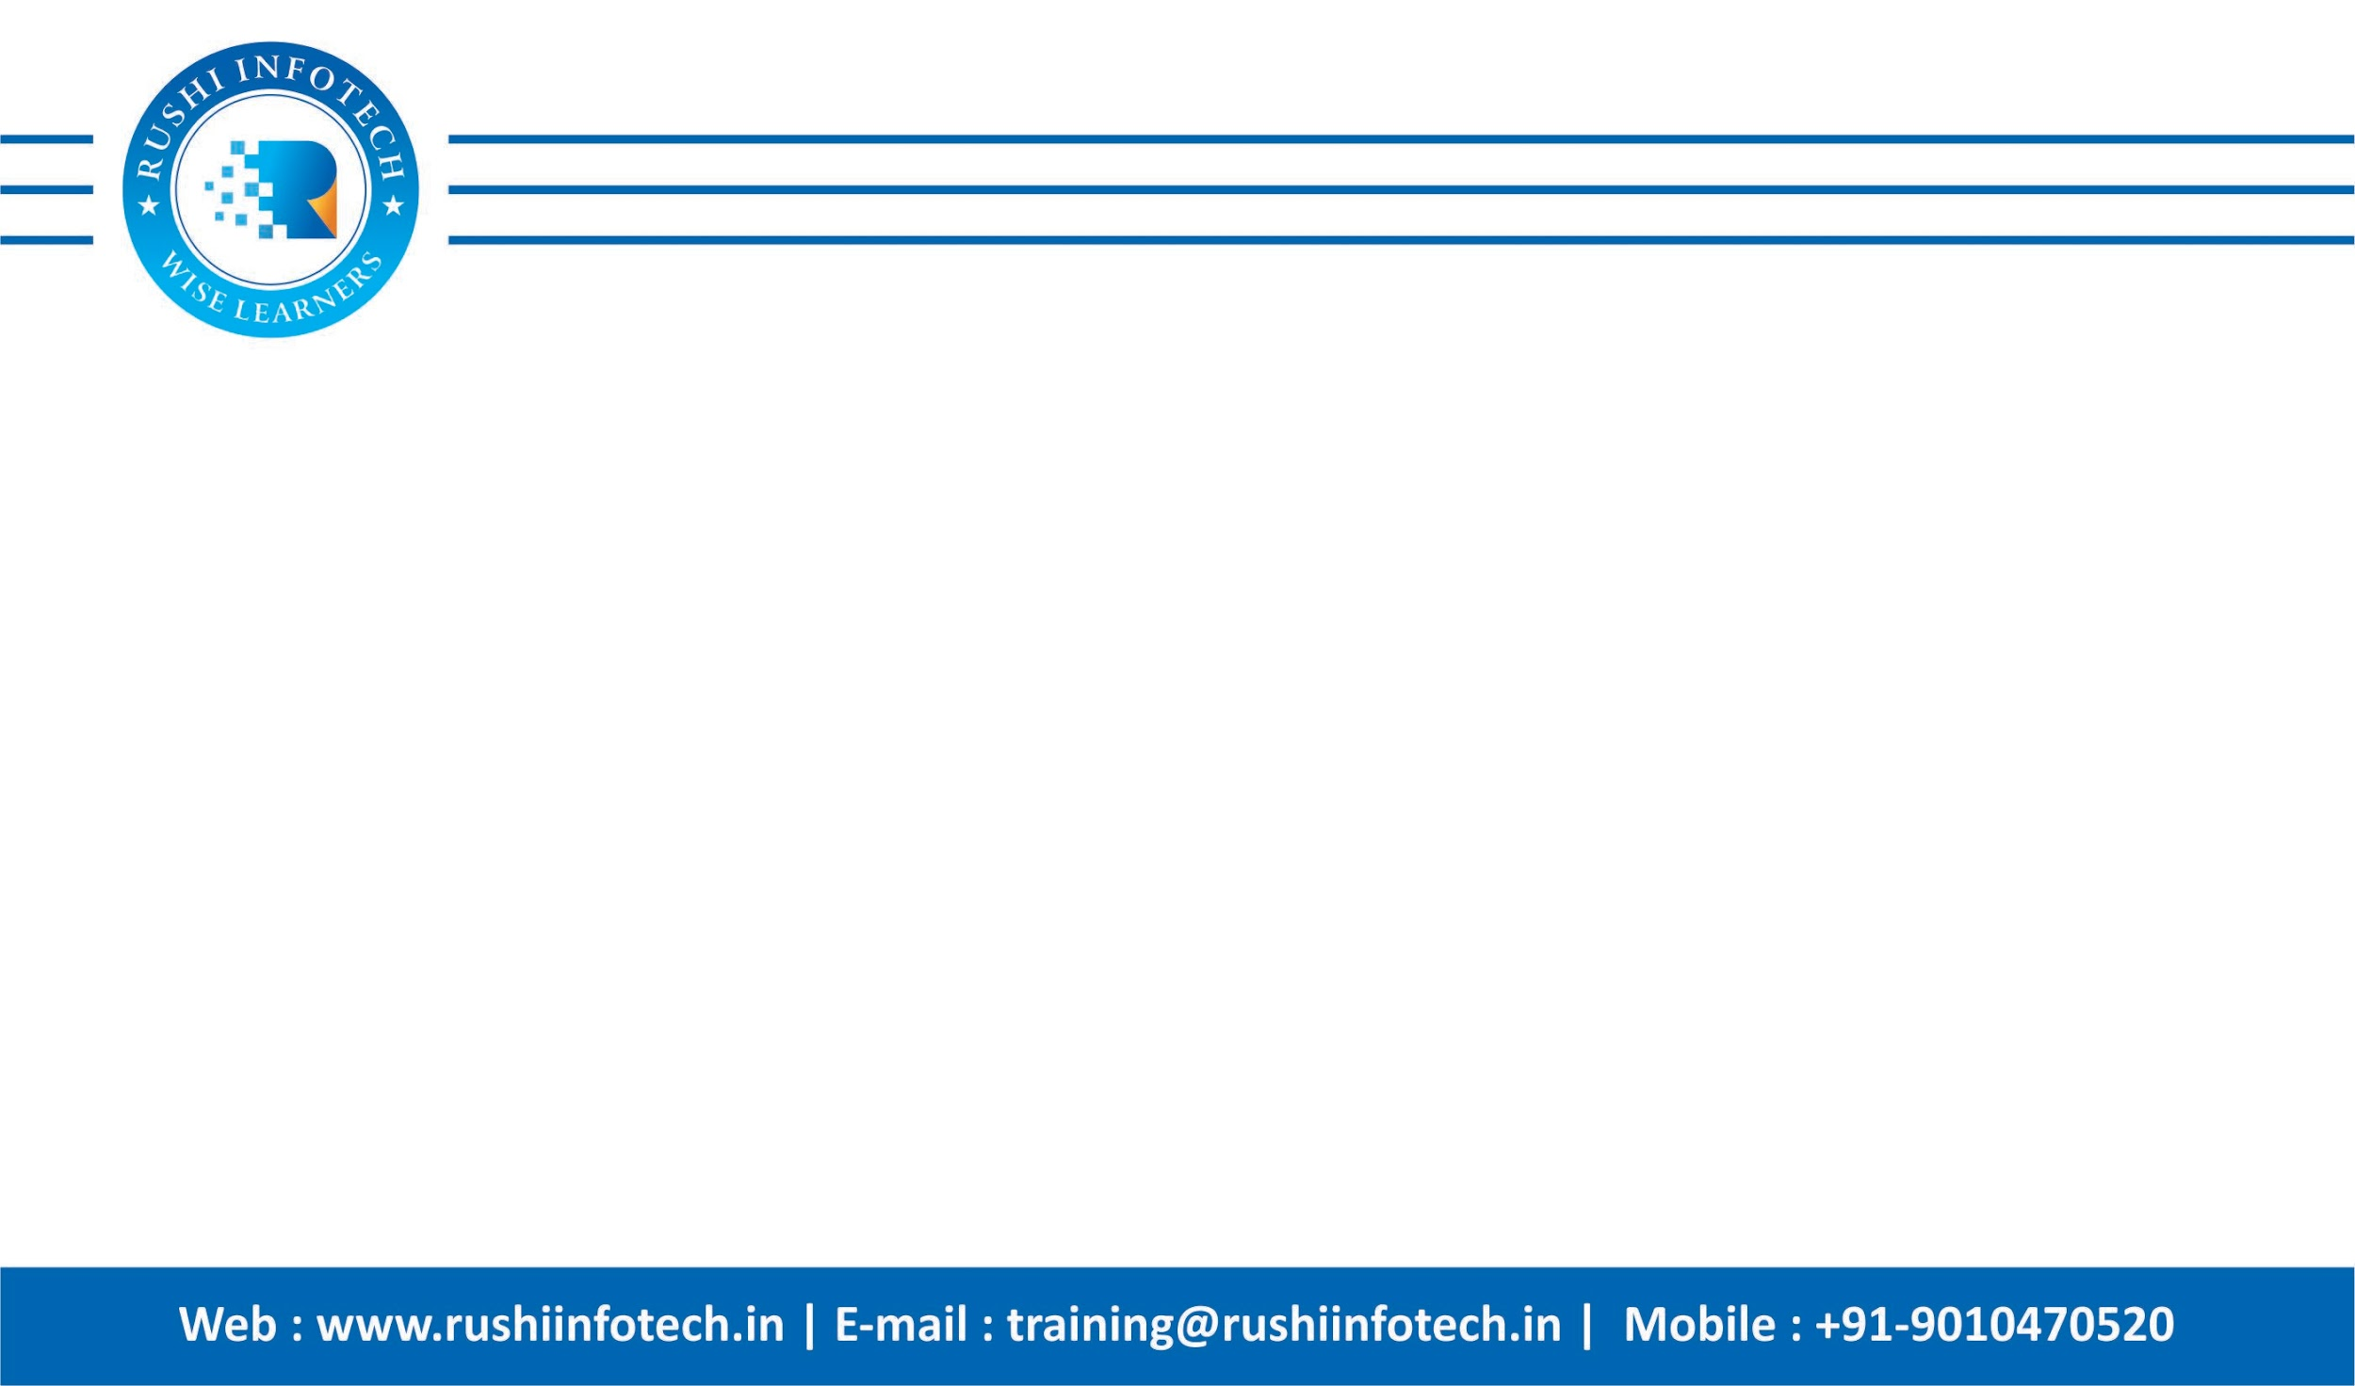

About Your Instructor:
Hi, I am Rushi, I have 10+ Years of Experience in the IT Industry with multiple Domain Experiences Like financial, E-commerce, and Healthcare
Currently working as a Lead DevOps Engineer specializing in Building CI CD Pipelines, Migrations, Implementing Microservices based Architecture, working on Multiple clouds, and End to end Automation
Passion in Doing R&D on New tools and Teaching is my Passion ☺

Slide 3





Connect with Us on
https://rushiinfotech.in/
https://clpdiy17.page.link/XKnc
https://www.youtube.com/@devopsandcloudbyrushi
9010470520, 7013882648
devopsbyrushi@gmail.co, training@rushiinfotech.in

Slide 4
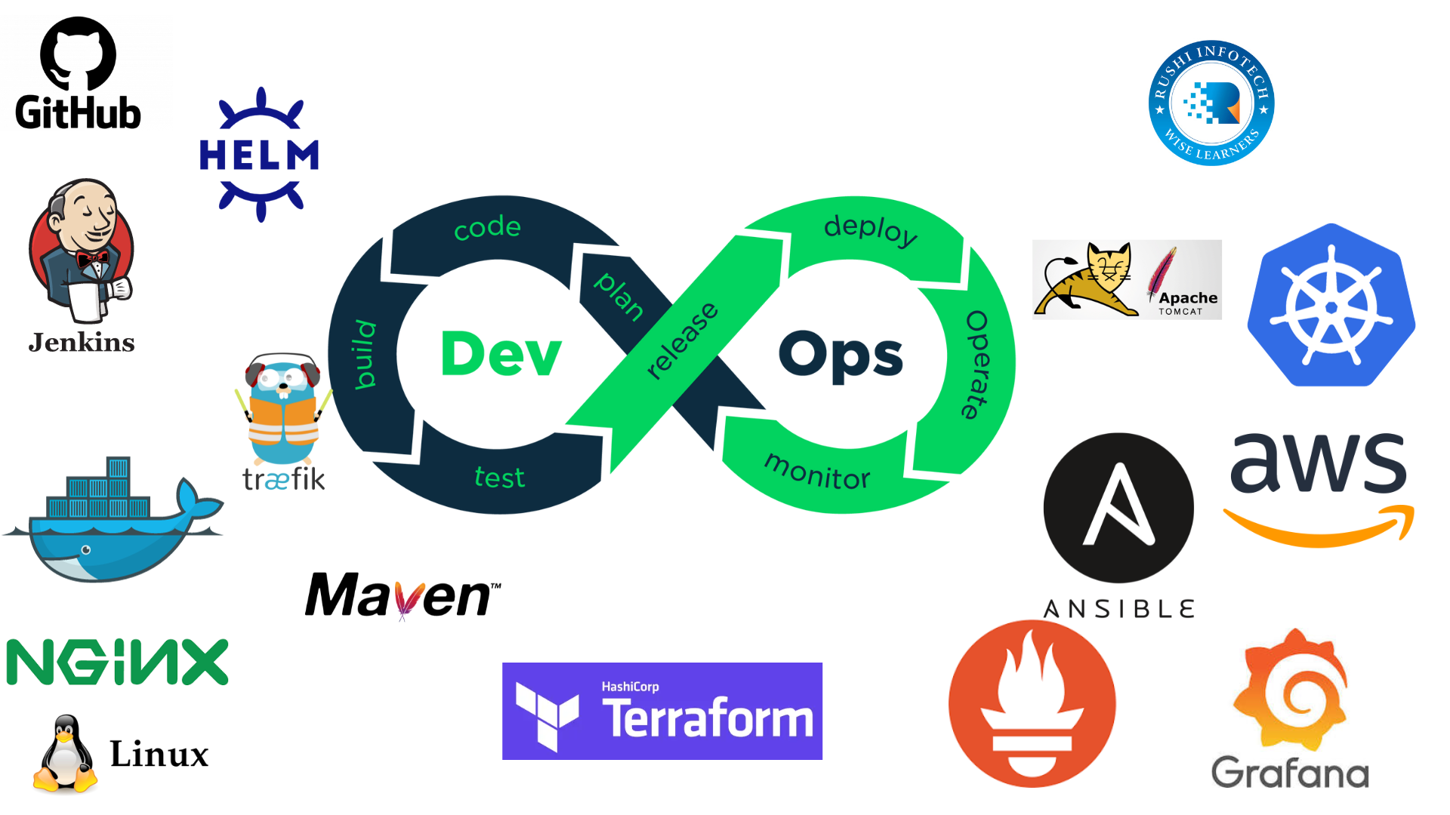

Slide 5
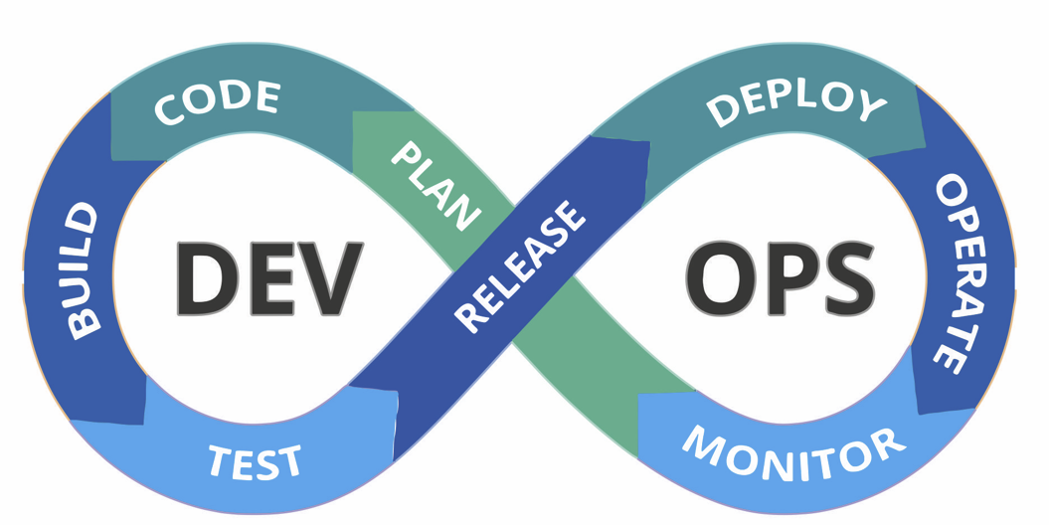
Who can learn DevOps Course?
- Software Developers
- System Administrators
- Network Administrators
- QA/Test Engineers
- IT Managers
- Release Engineers
- Operations Engineers
- DevOps Engineers
- Project Managers
- Entrepreneurs and Startup Founders
- Anyone interested in IT and software development

Slide 6
.
Module 1: Introduction to DevOps
Module 2: Linux Fundamentals
Module 3: Version Control Systems with GitHub
Module 4: Maven, and Tomcat
Module 5: Continuous Integration (CI) with Jenkins
Module 6: Docker
Module 7: Container Orchestration – Kubernetes
Module 8: Ansible
Module 9: Cloud - AWS
Module 10: Infrastructure as Code (IaC) – Terraform with AWS
Module 11: Infrastructure Monitoring- Prometheus and Grafana
Module 12: Scripting
Module 13: ArgoCD
Module 14: Live Projects Hands-on Labs, Resumes, Interview Questions, Mock Interviews, Naukri

Slide 7
Devops Tools
.
1.Git and Github
2.Linux
3.Maven
4.Tomcat
5.Jenkins
6.Docker
7.Kubernetes
8.Promotheous
9.Grafana
10.Shell script
11.ArgoCD
12.Terraform
13.Helm
14.AWS
15.Projects End to End Implementation

Slide 8
Module 1: Introduction to DevOps
What is DevOps?
History of DevOps
What is Dev and Ops
DevOps definition
DevOps and Software Development Life Cycle
What does a DevOps Engineer do
Who are DevOps engineers
Skills a DevOps Engineer must possess
The Popular DevOps Tools you should master
A Daily “Check List” of A DevOps Engineer OR DevOps Engineer Roles and Responsibilities

Slide 9
Module 2: Linux Fundamentals
Introduction to the Linux Operating System
Linux File System Hierarchy
Linux File & Directory Management
Linux Permissions and Ownership
User and Group Management
Linux Package Management
Winscp Scp Crontab
Passwordless authentication
Most useful commands like cp, mv, tar, yum, rpm, wget, rm, find, etc…
Permission Text Editing with Vim or Nano
Linux Monitoring Commands
Project on Linux:
Deploy Java Application with PostgreSQL Database on Tomcat Web Server
Deploy PHP Application with MySQL on Apache/Nginx Web Server
What is GIT?

Slide 10
Module 3: Version Control Systems with GitHub
Git Basics and Version Control Concepts
What is GIT?
Installing Git for Windows
Basic Commands Overview
Diff b/w Git and SVN
Git stages
Creating Branches in Git and Git Branching Strategies
Git merge and rebase
Backing Out Changes
Renaming and Moving Files & Deleting Files
Git Repository Setup
Git push, pull, and fetch
Git Stash, conflicts, fetch, merge, tags

Slide 11
Module 4: Maven, and Tomcat
Overview of Maven and Gradle
Diff b/w Maven and Gradle
How to install Maven/Gradle in Windows and Linux
Maven Phases and Lifecycle
Maven and Gradle Important config files for Application deployment
How to create. Jar, .war, and files using Maven and Gradle
How to add dependency files in Maven and Gradle
Install and Configuration of Tomcat
Deploy Java Project on Tomcat

Slide 12
Module 5: Continuous Integration (CI) with Jenkins
1. Introduction to Jenkins:
Overview of Jenkins and its role in DevOps
Installation and setup of Jenkins
Basic configuration and security settings
2. Building Jobs with Jenkins:
Creating and configuring Jenkins jobs
Building and compiling code
Triggering jobs manually and automatically
3. Source Code Management (SCM) Integration:
Integrating Jenkins with version control systems (e.g., Git)
Setting up webhooks and triggers for automatic builds
4. Jenkins Plugins:
Installing and managing Jenkins plugins
Popular plugins for source code management, build tools, and deployment

Slide 13
5. Jenkins Pipelines:
Introduction to Jenkins Pipelines
Declarative and scripted pipeline syntax
Building complex workflows with stages and steps
6. Automated Testing with Jenkins:
Setting up and running automated tests
Integration with testing frameworks (e.g., JUnit, Selenium)
Generating test reports
7. Continuous Integration (CI) Best Practices:
Principles of CI/CD
Best practices for Jenkins job configurations
Building and testing in parallel

Slide 14
8. Deployment and Continuous Delivery (CD) with Jenkins:
Configuring automated deployments
Blue-green deployments
Canary releases
9. Docker and Jenkins:
Docker integration with Jenkins
Building and pushing Docker images
Running Jenkins agents in containers
10. Jenkins Security: -
User authentication and authorization –
Securing Jenkins with role-based access control (RBAC) - Security plugins and best practices
11. Monitoring and Notifications: -
Integrating Jenkins with monitoring tools (e.g., Prometheus)
Setting up alerts and notifications (e.g., Slack, email)

Slide 15
12. High Availability and Scaling: -
Scaling Jenkins for larger workloads - Implementing Jenkins in a high-availability setup
13. Jenkins as Code: -
Managing Jenkins configurations as code (using tools like Jenkinsfile) - Version-controlling Jenkins configurations
14. Backup and Disaster Recovery: -
Creating backup and restore strategies for Jenkins - Planning for disaster recovery
15. Kubernetes Deployments using Jenkins : -
Deploy NodeApp and JavaApp to Kubernetes using Jenkins Pipeline
16. Real-World Use Cases and Case Studies: -
Examining real-world Jenkins implementations - Best practices in Jenkins usage

Slide 16
17. Final Project: - A practical project that involves setting up a complete CI/CD pipeline using Jenkins - Deployment of an application to a production environment

Slide 17
Module 6: Docker
1. Introduction to Docker
Introduction to Containers
What are containers?
Containerization vs. virtualization.
2. Docker Overview
Docker architecture.
Docker components (Docker Engine, Docker Hub, Docker Compose).
3: Installation and Setup
Installing Docker on various platforms (Linux, Windows, macOS).
Docker command-line basics.

Slide 18
4: Working with Images
- Creating Docker images.
- Docker Hub and image repositories.
- Dockerfile and image layers.
5: Managing Containers
- Creating, running, and stopping containers.
- Inspecting container metadata.
- Managing container data.
6: Docker Networking
- Docker networking concepts.
- Exposing container ports.
- Bridge and overlay networks.
.

Slide 19
7. Docker Compose and Orchestration
Docker Compose
- Defining multi-container applications with Compose.
- Compose commands and YAML syntax.
- Networking in Compose
8: Container Orchestration (Overview)
- Introduction to orchestration tools (Docker Swarm, Kubernetes).
- Pros and cons of orchestration.
9: Docker Swarm and Kubernetes
Docker Swarm
- Setting up a Docker Swarm cluster.
- Deploying services in Swarm.
- Scaling and managing services.

Slide 20
11: Docker Security
- Container security best practices.
- Docker security scanning.
12: Docker Volumes and Storage
- Managing data in containers.
- Docker volume types.
13: CI/CD with Docker
- Docker in continuous integration and continuous deployment (CI/CD) pipelines.
- Building and pushing Docker images in CI/CD.
Final Projects and Certifications:
-Project on Docker

Slide 21
Module 7: Container Orchestration – Kubernetes
1. Introduction to Kubernetes:
Overview of Kubernetes and its role in container orchestration
Basic architecture and components of Kubernetes
2. Setting Up Kubernetes:
Installation options (e.g., Minikube, kubeadm, EKS managed Kubernetes services)
Configuring a Kubernetes cluster
Cluster maintenance and upgrades
3. Deploying Applications:
Creating and managing Pods, Deployments, and Services
Using YAML manifests for resource definitions
Rolling updates and rollbacks

Slide 22
4. Managing Kubernetes Resources:
ConfigMaps and Secrets for Configuration Management
Persistent storage with PersistentVolumes and PersistentVolumeClaims
Resource quotas and limits
5. Networking in Kubernetes:
Service discovery and load balancing
Network Policies for Controlling Traffic
Ingress controllers and routing
6. Monitoring and Logging:
Using Prometheus for monitoring
Setting up Grafana dashboards
Centralized logging with tools like ELK (Elasticsearch, Logstash, Kibana)

Slide 23
7. High Availability and Scaling:
Strategies for high availability
Horizontal Pod Autoscaling (HPA)
Cluster scaling with node pools
8. Security in Kubernetes:
Role-Based Access Control (RBAC)
Pod security policies
Securing the Kubernetes API server
9. Kubernetes Operators:
Introduction to Operators and Custom Resource Definitions (CRDs)
Building custom Operators
Managing complex applications with Operators

Slide 24
10. Stateful Applications and Operators: -
Managing stateful workloads with StatefulSets - Deploying databases and other stateful applications - Using Operators for stateful application management
12. Cloud-Native Ecosystem: -
Exploring cloud-native technologies (e.g., Istio for service mesh, Knative for serverless) - Integrating Kubernetes with cloud services (e.g., AWS EKS,)
13. Multi-Cluster and Federation: -
Managing multiple Kubernetes clusters - Kubernetes federation and workload distribution

Slide 25
14. CI/CD with Kubernetes: -
Deploying applications using Jenkins- Building and pushing container images to registries - Automating deployments with Helm charts
15. Troubleshooting and Debugging: -
Strategies for diagnosing and resolving issues in a Kubernetes cluster - Debugging techniques and tools
16. Best Practices and Case Studies: -
Real-world Kubernetes use cases and case studies - Best practices in Kubernetes adoption
17. Projects on Kubernetes: -
A practical project that involves deploying and managing a complex application on a Kubernetes cluster - Implementing CI/CD pipelines for Kubernetes-based applications

Slide 26
Module 8: Ansible
1. Introduction to Ansible:
Overview of Ansible and its role in automation
Ansible architecture and components
2. Ansible Installation and Setup:
Installation options (e.g., package manager, pip)
Setting up the Ansible control node
Configuring Ansible for Remote Management
3. Ansible Ad-Hoc Commands:
Running ad-hoc commands to perform tasks on remote hosts
Managing inventory files
Ansible command-line options

Slide 27
4. Ansible Playbooks:
Creating and structuring Ansible playbooks
YAML syntax for defining tasks and plays
Variables and facts in Ansible
5. Ansible Modules:
Exploring Ansible modules for various tasks (e.g., file management, package installation, service management)
Using built-in and custom modules
6. Ansible Roles:
Organizing playbooks using roles
Role structure and best practices
Role dependencies

Slide 28
6. Ansible in CI/CD Pipelines: -
Integrating Ansible into CI/CD pipelines - Automating application deployment with Ansible
7. Ansible Best Practices: -
Best practices in Ansible automation - Code organization, naming conventions, and documentation
8. Troubleshooting Ansible Playbooks: - Debugging techniques and tools - Handling common errors and issues
9. Real-World Use Cases and Case Studies: -
Real-world Ansible automation use cases - Industry-specific case studies
10. Projects on Ansible: -
A practical project that involves automating a real-world IT task or infrastructure management task using Ansible

Slide 29
Module 9: Cloud - AWS
Introduction to AWS
AWS Account creation & free tier limitations overview
EC2 Instance Launch Wizard
EC2 Instance Types
Generating custom Public Key and Private keys for EC2 instances
volumes and Snapshots
Creating customized Amazon Machine Images
Elastic Load Balancers & Health Checks
Auto Scaling Groups
Cloud Watch

Slide 30
Creating Billing Alarm and EC2 instance alarms. VPC (Virtual Private Cloud):
Networking Basics
Creating custom VPCs and custom Subnets
Route Tables & IGW
VPN Configuration with AWS (OpenVPN) Elastic IP
Simple Notification Service
Databases RDS
Cost Optimization
AWS Backup service
AWS AMI

Slide 31
Module 10: Infrastructure as Code (IaC) – Terraform with AWS
1. Introduction to Terraform and AWS:
Overview of Terraform and its benefits
Introduction to AWS services and offerings
Setting up Terraform and AWS CLI
2. Terraform Basics:
Writing and organizing Terraform configurations (HCL)
Initializing a Terraform project
Understanding Terraform state and state management

Slide 32
3. AWS Resources with Terraform:
Provisioning AWS resources (e.g., EC2 instances, S3 buckets) using Terraform
Understanding resource dependencies and relationships
Managing resource attributes and parameters
4. Variables and Input:
Defining and using variables in Terraform configurations
Input variables, output variables, and data sources
Variable interpolation and dynamic values
5. Modules in Terraform:
Creating and using Terraform modules for reusable configurations
Best practices for module design and organization
Module versioning and registry usage

Slide 33
6. Terraform State Management:
Understanding remote state backends (e.g., AWS S3, Terraform Cloud)
Locking and concurrent access to state files
Managing state versions and backups
7. Terraform Providers:
Configuring AWS provider settings in Terraform
Using multiple providers in a single configuration
Provider version constraints and compatibility
8. Infrastructure as Code Best Practices:
Terraform best practices for code structure and organization
Managing sensitive data with variable files and secrets management
Code review and collaboration best practices

Slide 34
9. Terraform Functions and Expressions:
Using built-in Terraform functions and operators
Complex data manipulation and transformations
Conditional expressions and loops
10. Terraform Workspaces: -
Managing multiple environments and configurations with Terraform workspaces - Creating and switching between workspaces - Workspace-specific variables and state files
11. Advanced Terraform Topics: -
Handling remote-exec provisioners and user data - Integration with AWS Elastic Beanstalk and AWS Lambda - Data sources for information retrieval

Slide 35
12. Terraform and AWS Networking: -
Configuring VPCs, subnets, and security groups with Terraform - Managing route tables and peering connections - Network topology and architecture design
13. Managing AWS IAM with Terraform: -
Creating IAM users, roles, and policies - Fine-grained permissions management - IAM role assumption and trust relationships
14. Terraform Automation: -
Integrating Terraform with CI/CD pipelines - Automating the provisioning and deployment process - Integration with AWS CodePipeline
15. Terraform and AWS Modules: -
Exploring AWS-specific Terraform modules and best practices - Using community-contributed modules - Building custom modules for AWS resources

Slide 36
16. Terraform Security and Compliance: -
Security best practices in Terraform configurations - Compliance automation with Terraform - Infrastructure vulnerability scanning and remediation
17. Terraform and AWS Cost Management: -
Optimizing AWS resources for cost efficiency - Managing resource tags and cost allocation - Cost analysis and reporting with AWS Cost Explorer
18. Case Studies and Real-World Scenarios: -
Analyzing real-world Terraform and AWS deployments - Industry-specific case studies
19. Project on Terraform: -
A hands-on project that involves creating a complete infrastructure using Terraform for an AWS-based application or service - Deployment of resources to a production environment

Slide 37
Module 11: Infrastructure Monitoring- Prometheus and Grafana
1. Introduction to Monitoring and Observability:
Understanding the importance of monitoring in DevOps
Introduction to Prometheus and Grafana
2. Prometheus Fundamentals:
Overview of Prometheus architecture
Installing and configuring Prometheus
Prometheus data model: metrics, labels, and time series
3. Prometheus Queries and Alerting:
Using PromQL for querying and filtering metrics
Creating and managing alerts in Prometheus
Alert notification and routing

Slide 38
4. Exporters and Instrumentation:
Introduction to Prometheus exporters
Instrumenting applications with Prometheus client libraries
Using third-party exporters for various services
5. Grafana Introduction:
Overview of Grafana and its role in visualization
Installing and configuring Grafana
Adding Prometheus as a data source in Grafana
6. Creating Grafana Dashboards:
Building and customizing Grafana dashboards
Adding panels and visualizing Prometheus data
Templating and variables in Grafana

Slide 39
7. Alerts and Notifications with Grafana:
Setting up alerts in Grafana
Configuring alert conditions and thresholds
Integrating Grafana with alerting systems (e.g., email, Slack)
9. Case Studies and Real-World Scenarios: -
Analyzing real-world Prometheus and Grafana deployments - Industry-specific case studies
10. Project on Prometheus and Grafana: -
A hands-on project that involves setting up Prometheus for monitoring and Grafana for visualization for Kubernetes Cluster
Creating custom dashboards and alerts for an application or infrastructure

Slide 40
Additional Preparation
Shell Scripting
Resume
Real-time Interview Questions and Answers on Each Module
Troubleshooting Questions and Answers
End-to-End DevOps Projects with All Tools
Mock Interviews
One to one Hands-on Lab and Lab setup guide
Rushi Infotech App Access for Labs and Assignments

Slide 41


